Slide 1
Positive Roma Images
What are they and how to use them?

Slide 2
Discrimination & prejudice
Feeds off of information – misconceptions
Reinforced by visual images - stereotyping
Roma MATRIX public media campaign + wider PR/media relations work will challenge both
Goal = challenging, shifting, changing attitudes, understanding, perceptions……..+ behaviour?.......of OTHERS (Target audiences)

Slide 3
Role of Positive Images
To sit at the heart of activity. Both:
the public media campaign
AND, PR / media relations work
Positive images = one component in the wider strategy…..an important piece of the jigsaw.
Also important, and closely linked, is Key Messages

Slide 4
Twin tactics
Key messages
Positive images
Short statements
Factual or emotional
That can be supported
Backed up with evidence
EG:
Roma are people just like you and me
More and more Roma are getting trained for employment
Roma people have University degrees too
Pictures / visuals
That tell a story
Support a key message
Bring it to life
Which image will support our key messages?

Slide 5
What Key Messages come to mind?

Slide 6
What do we want our Key Messages and Positive Images to do?
Challenge stereotypes
Present an alternative reality
Make people ‘stop and think’
…..and change behaviour towards Roma?
Used together = a powerful combination
We need to develop and use both

Slide 7
Guiding principles – THE 3 C’s
Clarity
Consistency
Constancy
Make your point
Don’t confuse the point
Do not use too many key messages or images
Use them regularly and often
Say/show the same thing (repeatedly)
Link key messages & images

Slide 8
Varna meeting (Workstream 4)
Our workshop on developing a positive Roma image

Slide 9
The positive image workshop
2 working groups
Worked with large selection of images
Wide range of images
The Brief:
Select a few ‘positive’ and ‘negative’ images for use in the campaign
Why are they positive and negative?
How should we select a positive image?

Slide 10
Results

Slide 11
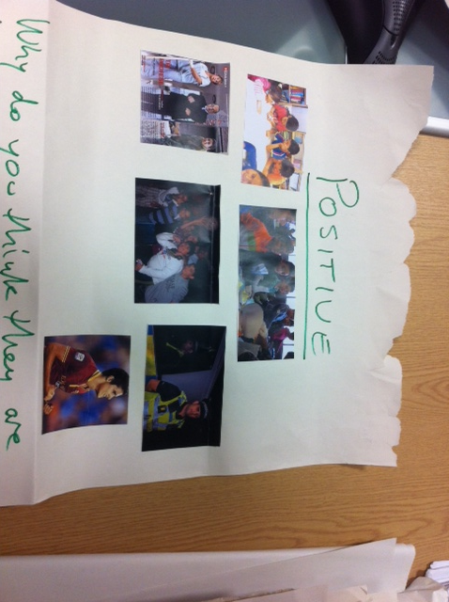

Slide 12
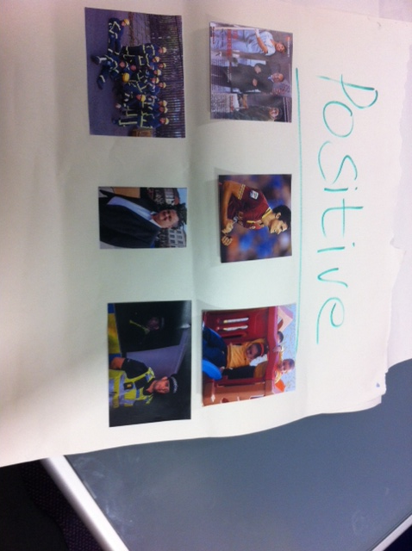

Slide 13
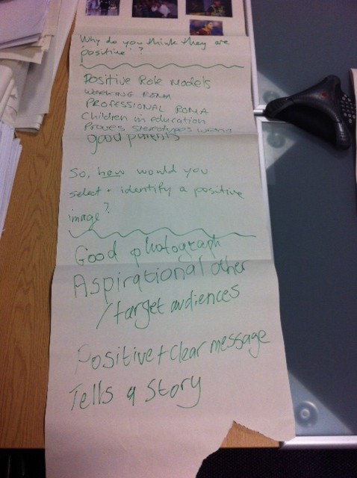
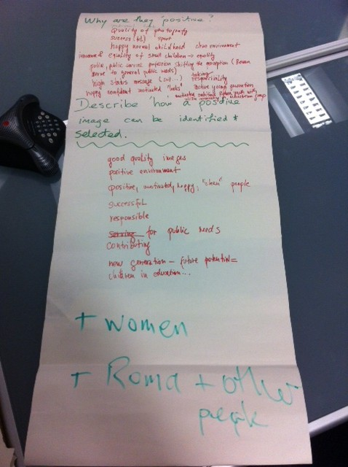

Slide 14
The emerging ‘brief’ / ‘guidance’
Show Roma in normal everyday situations
In work and in education etc.
Mix of men and women
Interacting with other people (being included)
Avoid ‘expected’ (e.g. cultural / poverty)
Chose images that will:
‘POSITIVELY SURPRISE’

Slide 15
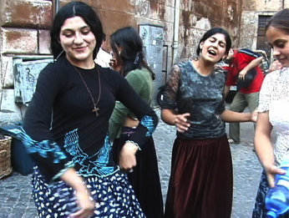
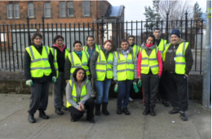
For example…
Key message
Supporting image?
More and more Roma are getting involved in work-related training and are getting ready for employment

Slide 16
For example…
Key message
Supporting image?
More and more Roma are getting involved in work-related training and are getting ready for employment
✔

Slide 17
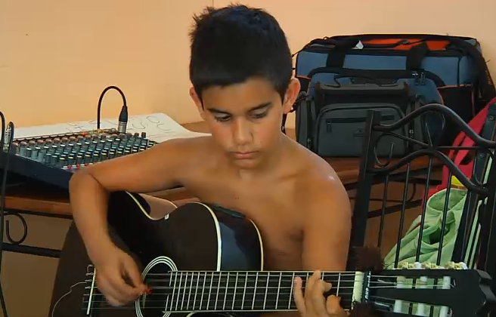
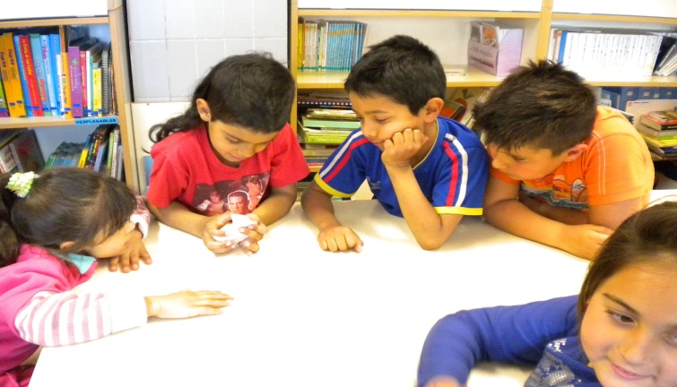
Key message
Supporting image?
The majority of young Roma are now attending school and are doing well.

Slide 18
Key message
Supporting image?
The majority of young Roma are now attending school and are doing well.
✔

Slide 19
But….
What about positive cultural images – Roma dance and music?
That are precious to Roma
But are they ‘positively surprising’?
What about images that bring to life the reality of discrimination?
They may be ‘positively shocking’
Is there a role for them in your work?

Slide 20
Proposed solution
Focus with some flexibility:
A core bank of ‘positively surprising’ positive images (for the campaign)
A supplementary bank of other positive images (e.g. Roma culture)
A supplementary bank of ‘other’ images for use in appropriate situations (e.g. to evidence discrimination and racism).

Slide 21
Next steps?
Written guidance will be issued by MY
Images will be stored on the new Extranet
Each partner responsible for adding images to the appropriate part (e.g. folder) of the image bank
Partners responsible for securing ‘consent’
All partners can access and use the image bank
The image back will be used later for the ‘Exhibition of Positive Roma Images’

